Slide 1
Geomagnetism and the European Plate Observing System (EPOS)
What We’ve Learned About Integrating Geomagnetic Data Into an Earth Observation Network
Simon Flower [1], Pavel Hejda [2], Aude Chambodut [3], Juan-Jose Curto [4], Jürgen Matzka [5], Alan Thomson [1], Maxim Smirnov [6] and Ari Viljanen [7]
(1) British Geological Survey, UK Research and Innovation, Edinburgh, UK, (2) Institute of Geophysics, Academy of Sciences of the Czech Republic, Prague, Czech Republic, (3) Ecole et Observatoire des Sciences de la Terre, Université de Strasbourg, Strasbourg, France, (4) Observatori de l’Ebre, Roquetes, Spain, (5) Niemegk Observatory, Deutsche GeoForschungsZentrum, Potsdam, Germany, (6) Geosciences and Environmental Engineering Department, Luleå University of Technology, Luleå, Sweden, (7) Finnish Meteorological Institute, Helsinki, Finland.
Notes:
Abstract: The European Plate Observing System (EPOS) is "a long-term plan to facilitate integrated use of data, data products, and facilities from distributed research infrastructures for solid Earth science in Europe" [https://epos-ip.org/about/what-epos]. The preparatory phase ran from 2010 to 2014, the implementation phase completes in September this year, after which EPOS will become operational. The EPOS community consists of 141 institutes and 47 partners from across 22 countries, including several international organisations, such as INTERMAGNET. EPOS activities are organised around 10 science themes, of which geomagnetism is one. This presentation will discuss how geomagnetism has contributed to EPOS; what has worked well and what has not. The focus will be on how we make data 'interoperable' (Merriam-Webster: "ability of a system to work with or use the parts or equipment of another system") in the context of a large scale Earth Observation Network. As EPOS is a 'work in progress' the presentation will also cover the areas where we still have work to do and where the end result is, as yet, unclear.

Slide 2
EPOS Vision
EPOS vision is that the integration of the existing national and trans-national research infrastructures will increase access and use of the multidisciplinary data recorded by the solid Earth monitoring networks, acquired in laboratory experiments and/or produced by computational simulations. The establishment of EPOS will foster worldwide interoperability in the Earth sciences and services to a broad community of users.
[https://www.epos-ip.org/about/what-epos]

Slide 3
EPOS Mission
EPOS mission is to integrate the diverse and advanced European Research Infrastructures for solid Earth science, and build on new e-science opportunities to monitor and understand the dynamic and complex solid-Earth System. EPOS will identify existing gaps and promote implementation plans with environmental, marine and space science to help solve the grand challenges facing the Earth and its inhabitants.
[https://www.epos-ip.org/about/what-epos]

Slide 4
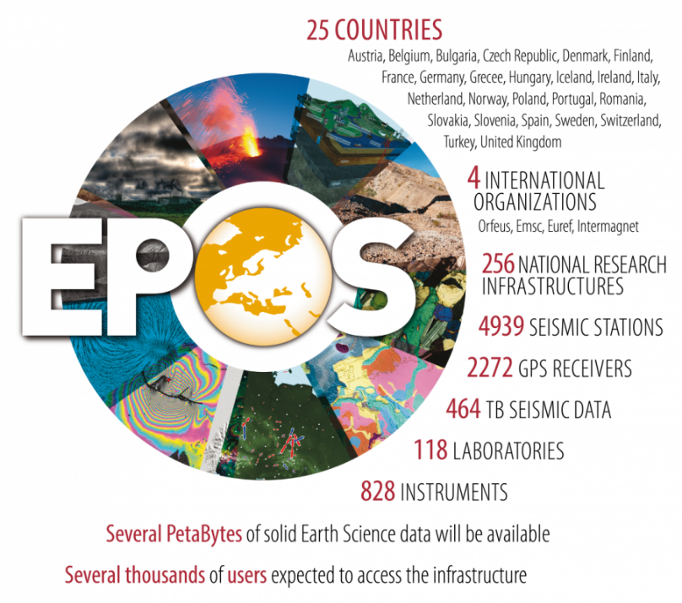
EPOS
Sarah is a project PI and part of the DeepNL program. She wants to create a model with the purpose of simulating the surface subsidence above the Groningen Gas field for the next decades. The numerical model requires input from:
a) Satellite-based surface subsidence data from the past 30 years
b) Location, time, magnitude, and focal mechanism of earthquakes in the area
c) A geological model of the subsurface based on seismic and well data
d) Rock mechanical data (rheology, geochemistry, failure properties) from the underlying lithologies
e) Industrial data (gas production / production cluster position)
The task: Bring together Geoscience data and services from across Europe in a way that allows them to be easily combined.
The goal: New scientific discoveries
Notes:
EG, current difficulty combining seismic and geomagnetic data
EG climate change. “There’s the fundamental science – the physics, the chemistry and so on,, but there’s also the social science: how do we get people to change their behaviour? And the engineering aspects: how do we design more efficient power generation systems, and improve insulating technologies?” [https://www.newscientist.com/article/mg20928002-100-open-your-mind-to-interdisciplinary-research/]
EG EPOS:
Sarah is a project PI and part of the DeepNL program. She wants to create a model with the purpose of simulating the surface subsidence above the Groningen Gas field for the next decades. The numerical model requires input from:
a) Satellite-based surface subsidence data from the past 30 years (e.g. Satellite; GNSS)
b) Location, time, magnitude, and focal mechanism of earthquakes in the area (e.g. Seismology)
c) A geological model of the subsurface based on seismic and well data (e.g. Geological info & Modeling)
d) Rock mechanical data (rheology, geochemistry, failure properties) from the underlying lithologies (e.g. Multi-scale laboratories) à location (depth?)
e) Industrial data (gas production / production cluster position)

Slide 5
EPOS Phases
CP
Conception Phase
2002 – 2008
IP
Implementation Phase – Horizon 2020
2014 -2019
ERIC
Operational Phase, ERIC – Legal entity
2020 -
PP
Preparatory Phase – FP 7
2010 – 2014
Notes:
ERIC - European Research Infrastructure Consortium

Slide 6
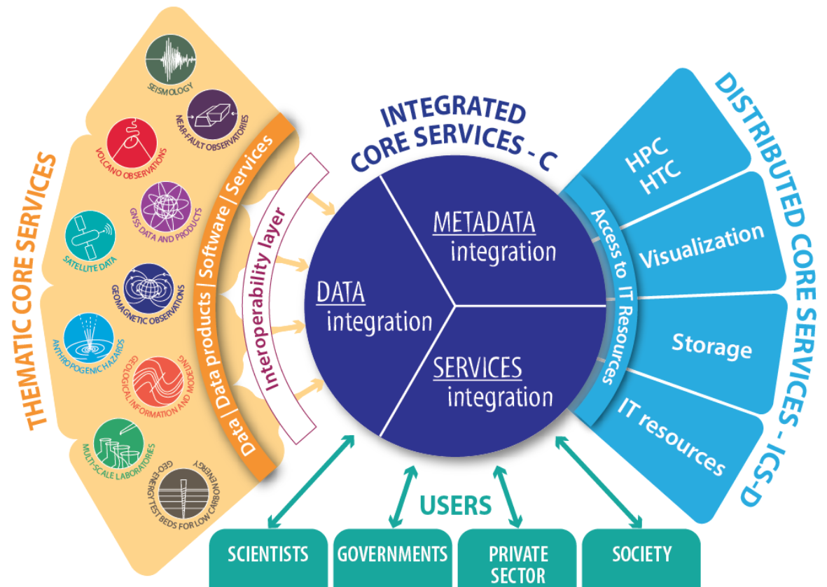
EPOS Organisation

Slide 7
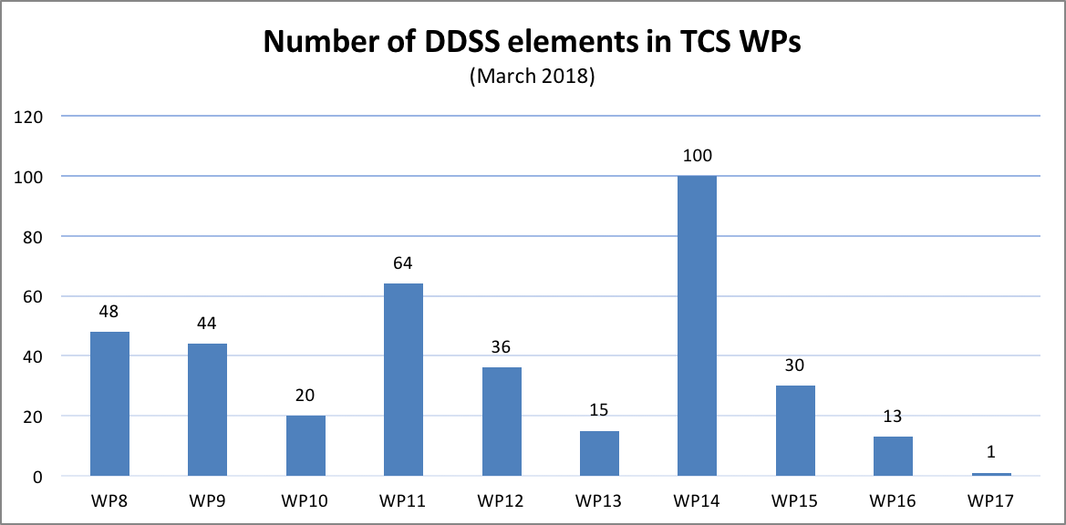
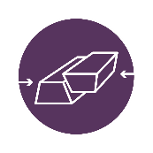
EPOS Geoscience Data Sets
Data, Data products, Software and Services
Notes:
• WP1: Management
• WP2: Communication
• WP3: Harmonization
• WP4: Legal
• WP5: Finance
• WP6: ICS Interoperability
• WP7: ICS development
• WP8: Seismology
• WP9: Near-Fault Observatories
• WP10: GNSS
• WP11: Volcano Observatories
• WP12: Satellite Earth Observations
• WP13: Geomagnetic Observations
• WP14: Anthropogenic hazards
• WP15: Geology
• WP16: Multi-scale Laboratories
• WP17: Geo-­Energy Test Beds.

Slide 8
EPOS Geomagnetic Data Sets
Dataset | Source | Available
Geomagnetic observatory data | World Data Centre & INTERMAGNET | 2017/18
Variometer data | IMAGE + Baltic extensions | 2017/18
Geomagenetic indices | ISGI | 2017/18
Geomagnetic events | Obervatori de L’Ebre | 2017/18
Electrojet indices (IE/IL/IU) | IMAGE | 2017/18
Global magnetic models | IGRF and WMM | 2017/18
Magnetic survey data | World Data Centre | 2018
Substorm events | IMAGE | 2018
Magnetotelluric time series | New data repository | 2019
Magnetotelluric transfer functions | New data repository | 2019
Lithospheric conductivity models | New data repository | 2019
World digital magnetic anomaly map | WDMAM | 2019

Slide 9
How Do We Integrate?
Integrate = "ability of a system to work with or use the parts or equipment of another system“ [Merriam-Webster]
Make our data “Interoperable”
“Data interoperability addresses the ability of systems and services that create, exchange and consume data to have clear, shared expectations for the contents, context and meaning of that data.” [http://datainteroperability.org]
FAIR data principles: Come from data science research, published in 2016

Slide 10
EPOS “FAIR” Data - Findable
(meta)data are assigned a globally unique and eternally persistent identifier.
data are described with rich metadata.
(meta)data are registered or indexed in a searchable resource.
metadata specify the data identifier.
[https://www.force11.org/group/fairgroup/fairprinciples]
Notes:
Rich metadata implies that you should not presume that you know who will want to use your data, or for what purpose. So, as a rule of thumb, you should never say ‘this metadata isn’t useful’; be generous and provide it anyway!

Slide 11
EPOS “FAIR” Data - Accessible
(meta)data are retrievable by their identifier using a standardized communications protocol.
the protocol is open, free, and universally implementable.
the protocol allows for an authentication and authorization procedure, where necessary.
metadata are accessible, even when the data are no longer available.
[https://www.force11.org/group/fairgroup/fairprinciples]

Slide 12
EPOS “FAIR” Data - Interoperable
(meta)data use a formal, accessible, shared, and broadly applicable language for knowledge representation.
(meta)data use vocabularies that follow FAIR principles.
(meta)data include qualified references to other (meta)data.
[https://www.force11.org/group/fairgroup/fairprinciples]
Notes:
Metadata language examples: ISO19115, Inspire, Datacite
A qualified reference is a cross-reference that explains its intent. For example, X is regulator of Y is a much more qualified reference than X is associated with Y, or X see also Y. The goal therefore is to create as many meaningful links as possible between (meta)data resources to enrich the contextual knowledge about the data, balanced against the time/energy involved in making a good data model.

Slide 13
EPOS “FAIR” Data - Reusable
meta(data) have a plurality of accurate and relevant attributes.
(meta)data are released with a clear and accessible data usage license.
(meta)data are associated with their provenance.
(meta)data meet domain-relevant community standards.
[https://www.force11.org/group/fairgroup/fairprinciples]
Notes:
The ultimate goal of FAIR is to optimise the reuse of data

Slide 14
EPOS Metadata & Geomagnetism
Source
Geomagnetism Community Metadata
A database schema for global geomagnetic metadata
Peer reviewed (geomagnetic community and database experts)
EPOS Data Catalogue Vocabulary Application Profile (EPOS DCAT AP)
“DCAT is an RDF vocabulary designed to facilitate interoperability between data catalogs published on the Web” [https://en.wikipedia.org/wiki/Data_Catalog_Vocabulary]
Status: W3C draft standard
Syntax: Terse RDF Triple Language (Turtle)
Common European Research Information Format (CERIF)
Describes research entities and their relationships
A database model and implementation
[https://www.eurocris.org/cerif/main-features-cerif]
Transport
Storage
Notes:
EPOS DCAT AP - EPOS Data Catalogue Vocabulary Application Profile
RDF – Resource Description Framework
Based on statements (known as the subject, predicate and object

Slide 15
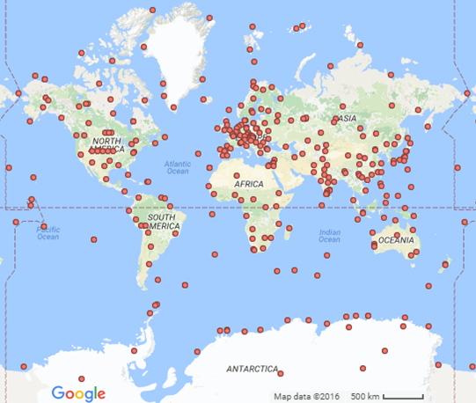
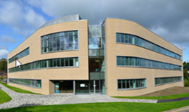
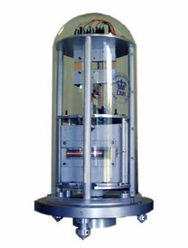
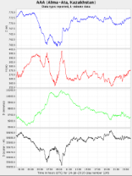
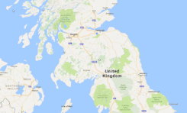
Geomag Metadata - What We Record
Institutes
Instruments
People
Data
Locations
180 active, 360 inactive observatories
200 contacts in 125 institutions
Many instruments creating thousands of data sets
Notes:
What is the source of the metadata that we provide to EPOS?
These figures are from the World Data Centre metadata database from about 2017
The data that we need to collect is sufficiently large and complex to need a data management tool,
INTERMAGNET figures: 61 institutes, 132 active observatories, 17 former observatories

Slide 16
Geomag Metadata – Design Goals
A single database for the whole community
Easy for data providers to understand and update
Easy for users to query and obtain data
Contains information needed for the INTERMAGNET website, INTERMAGNET data DVD, World Data Centre web site (amongst others)
Ideal: Be able to create a yearbook
Conform to metadata standards (such as ISO 19115) to allow our data to be understood by users outside our community
Need to ensure both these things
Notes:
I think that the ‘gold standard’ for a geomagnetic metadata system is that we would have enough information to allow us to create the digital equivalent of a yearbook from the metadata for any of the digital data sets that we are collecting. We won’t get to this level with the first version of the system, but the idea of being able to recreate a yearbook from the metadata should continue to be an aspiration.
ISO 19115 is a standard for geographic metadata. INSPIRE is a related standard that is mandatory in Europe

Slide 17
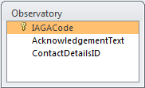
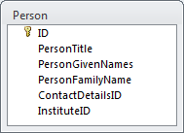
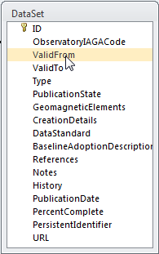
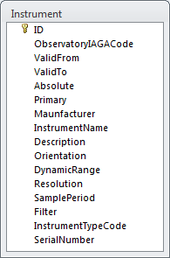
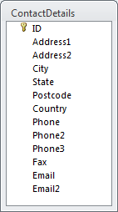
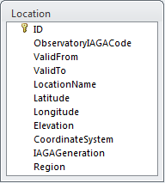
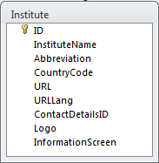
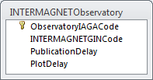
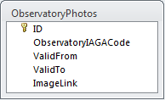
Geomag Metadata – The Schema
Peer Reviewed
Notes:
Designed to capture these things about an observatory:
What institute or institutes does it belong to and is it supported by
What is it’s location
Who are the contacts for the observatory
What instruments are / have been in operation at the observatory
What data sets has the observatory produced
Is the observatory a member of INTERMAGNET
All these attributes may vary over time – the metadata allows for this
This is a subset of the information held in the schema – for a more detailed description, contact me

Slide 18
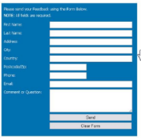
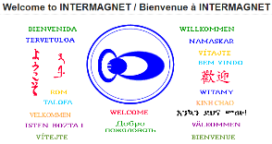
Geomag Metadata - Progress
Self service data entry
Web services
Tools to create INTERMANGET DVD metadata
Other clients
Feed to INTERMAGNET web site
Geomagnetic metadata database
Tools for database administration
Feed to EPOS data portal
Notes:
An easy to use data entry service will be provided. This will allow data providers to update entries for their own institutes and observatories
Feeds will be provided to satisfy the specific requirements of a number of clients (INTERMAGNET and EPOS shown in the diagram – others expected to follow). The basic design will be flexible, allowing new clients to be added as needed.
Tools will be available to allow the operators of the database to enter and delete data.
The system will initially be implemented at the British Geological Survey. It will be designed to be flexible in it’s implementation, so that it could be moved to another institute, if required.

Slide 19
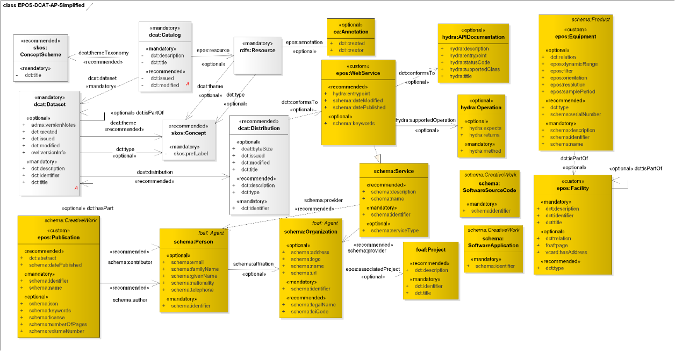
EPOS Metadata – EPOS DCAT AP
27 Entities, including:
Dataset
Dataset distribution, Web service, Web service operation
Facility, Equipment
Person, Contact point, Organisation

Slide 20
EPOS DCAT – EG INTERMAGNET
<mailto:smf@bgs.ac.uk> a schema:Person;
schema:identifier [ a schema:PropertyValue;
schema:propertyID "mailto";
schema:value "smf@bgs.ac.uk";
];
schema:familyName "Flower";
schema:givenName "Simon";
schema:address [ a schema:PostalAddress;
schema:streetAddress "The Lyell Centre, Research Avenue South";
schema:addressLocality "Edinburgh";
schema:postalCode "EH14 4AP";
schema:addressCountry "United Kingdom";
];
schema:email "smf@bgs.ac.uk";
schema:telephone "+44 131 650 0238";
schema:url "http://www.bgs.ac.uk/staff/profiles/0447.html"^^xsd:anyURI;
schema:affiliation <http://viaf.org/viaf/136554353/>;
schema:contactPoint <mailto:smf@bgs.ac.uk/contactPoint>;
.

Slide 21
EPOS DCAT – EG INTERMAGNET
<https://www.epos-eu.org/epos-dcat-ap/GeoElectroMagnetism/WP13-DDSS-001/INTERMAGNET/Operation> a hydra:Operation;
hydra:method "GET"^^xsd:string;
hydra:returns "text/xml";
hydra:returns "application/json";
hydra:returns "application/covJson";
hydra:returns "text/plain";
hydra:property[ a hydra:IriTemplate;
hydra:template "http://geomag.bgs.ac.uk/EPOS/WP13/intermagnet/{?Request, observatoryIagaCode, SamplesPerDay, dataStartDate, dataDuration, publicationState, recordTermination, traceList, colourTraces, pictureSize, pdfSize, dataScale, Format}"^^xsd:string;
hydra:mapping[ a hydra:IriTemplateMapping;
hydra:variable "observatoryIagaCode"^^xsd:string;
rdfs:label "Observatory IAGA code";
rdfs:range "xsd:string" ;
schema:defaultValue "ESK";
hydra:required "true"^^xsd:boolean;
];
Notes:
Full file, just to describe INTERMAGENT, currently incomplete at 10,000 lines

Slide 22
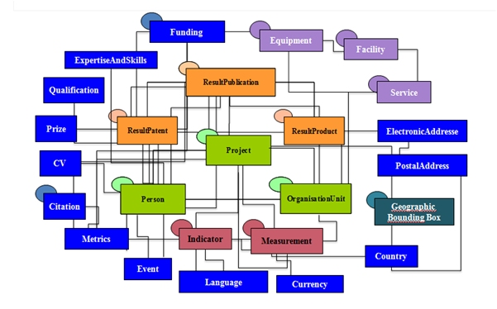
EPOS Metadata - CERIF

Slide 23
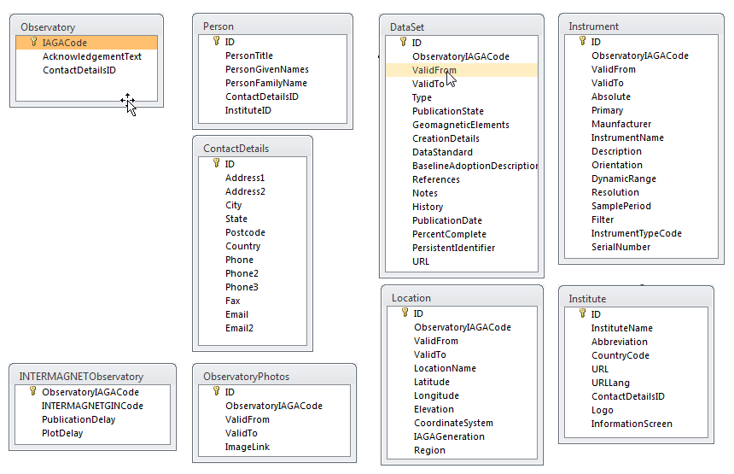
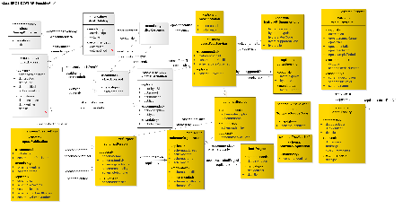
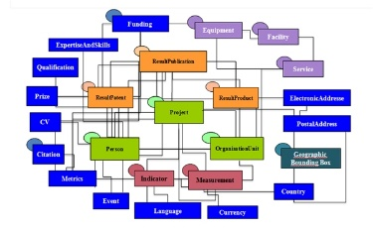
EPOS Metadata & Geomagnetism
Geomagnetism
EPOS DCAT AP
CERIF

Slide 24
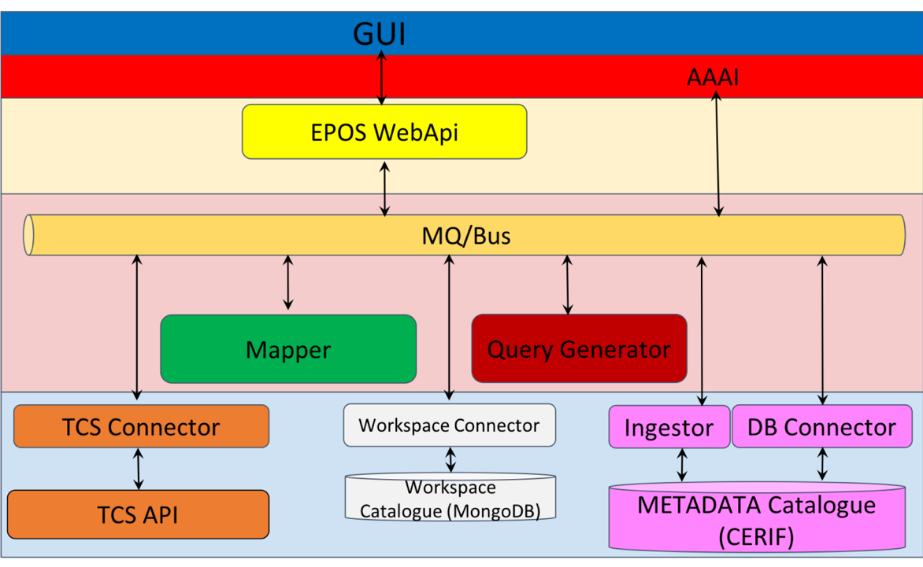
EPOS Data - User Interface
Notes:
AAAI – Authentication, Authorization and Accounting Infrastructure

Slide 25
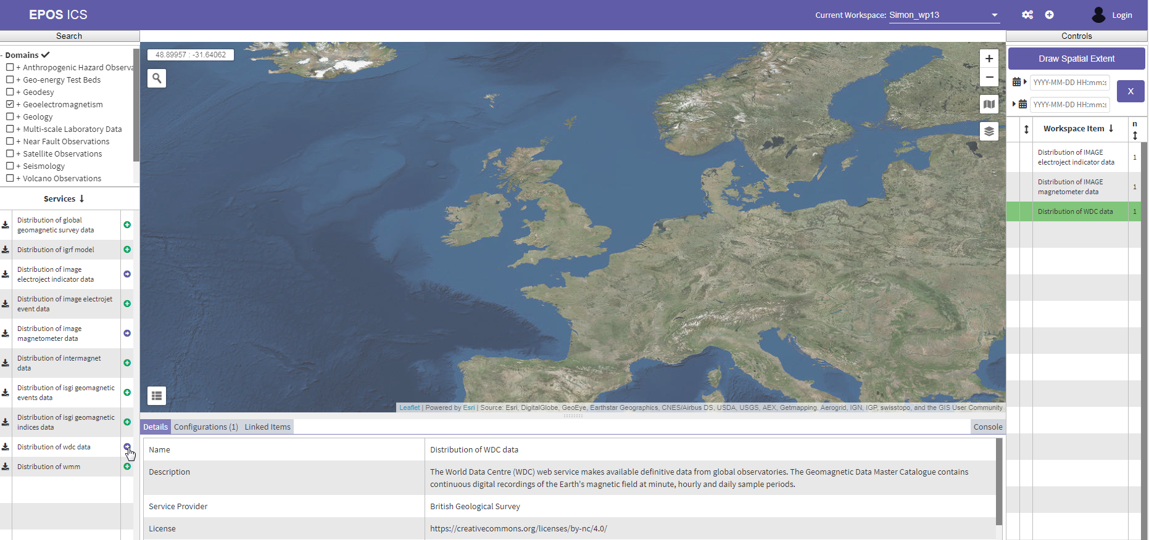
EPOS Data - User Interface
Missing any way to view time series data

Slide 26
EPOS Data – Time Series
We need a single format that can support:
Coverage JSON (CovJSON) Point Series:
https://covjson.org/domain-types/#pointseries
Data type | GUI pre-visualisation
Geo-referenced points Geo-referenced images | Map
Geo-referenced time series | Time Series
Non-geo-referenced elements | Other
Notes:
Aims to be able to represent any spatiotemporal data (data with both spatial and temporal variations)
An open standard
Comprehensive ability to handle spatial as well as time series data
A “playground” has been created, where CovJSON documents can be tested for conformity: https://covjson.org/playground/
Some linkage to RDF
A draft standard – the final implementation may change. However we have not found any more mature JSON-based time series formats
Lack of existing tools that work with the format
Relatively easy to write code for this format
Some sample code is provided in the “playground”

Slide 27
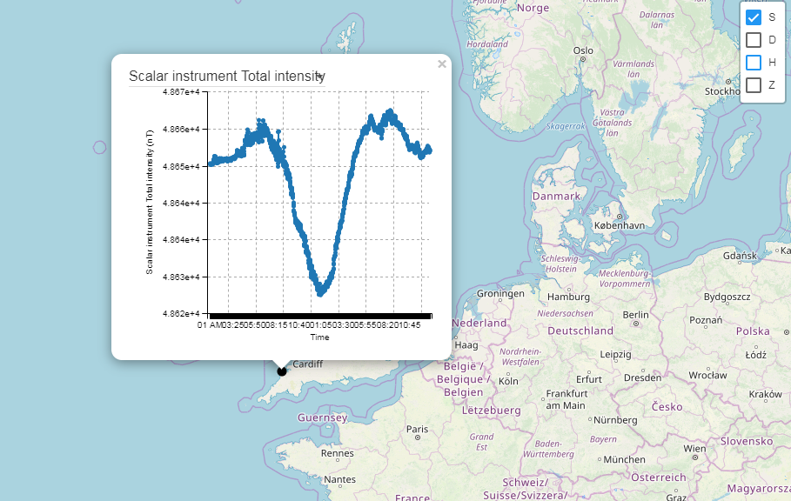
EPOS Data – Time Series
Notes:
This work is incomplete

Slide 28
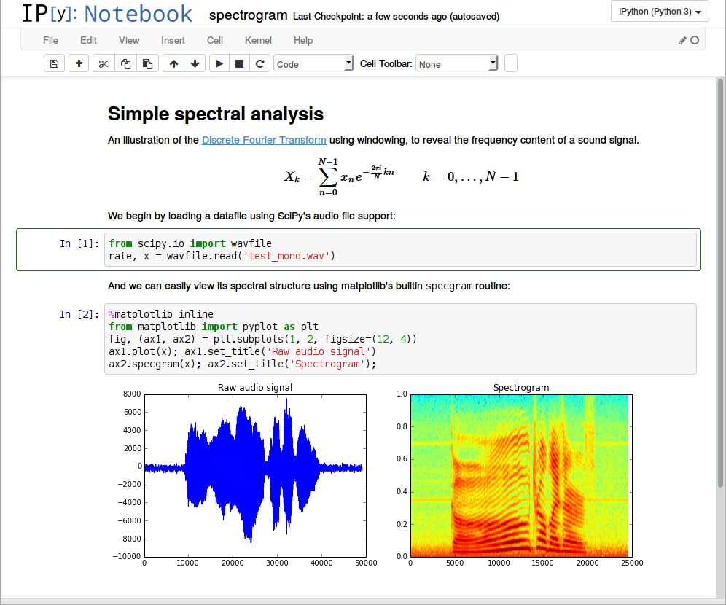
EPOS Data – Data Processing

Slide 29
EPOS Other Work
Geomagnetic indices
Magnetotelluric data
Data management plans
Licensing
Supplier letters
User feedback forums
Consortium agreement
Financial plan

Slide 30
EPOS Future
Magnetotelluric services to be implemented
Add to EPOS DCAT AP metadata
Populate Geomagnetism community metadata
Standardise our web formats (JSON)
Respond to user feedback

