Slide 1
INTERMAGNET Reference Data Set and Digital Object Identifiers
Simon Flower, with thanks to:
Kirsten Elger and DAMIAN ULBRICHT (GFZ)
Jan Reda and the INTERMAGNET Data Checking TEam
Notes:
The INTERMAGNET Reference Data Set is the new way that we will publish data. INTERMAGNET will no longer publish on a physical medium. Instead we will publish the data as Digital Object Identifiers or “DOIs”.

Slide 2
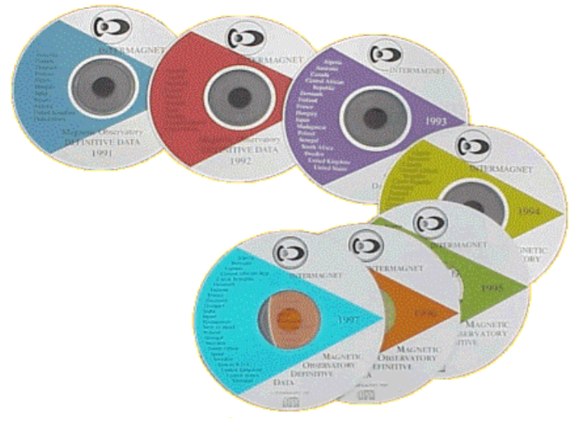
Progress: DOIs published for 2013 and 2014
https://doi.org/10.5880/INTERMAGNET.2013
https://doi.org/10.5880/INTERMAGNET.2014
2014 the last ‘single-year’ publication
Notes:
INTERMAGNET definitive data for 2013 and 2014 was published on USB stick. We have created DOIs for these two publications, and you can see them at the URLs shown. 2014 is the last year where we will publish a single year of data. From 2015 onwards, the entire INTERMAGNET definitive data set from 1991 onwards will be published each year.

Slide 3
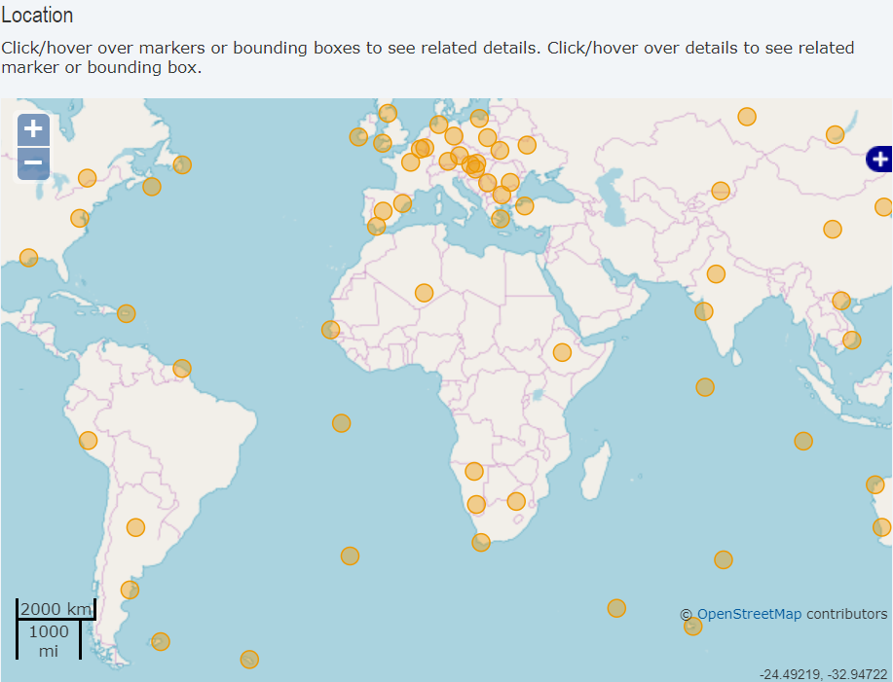
Features of the DOI landing pages View the contributing observatories
Notes:
The next slides show some of the features of the DOI landing pages that we have created.
Because the metadata for the DOI includes information about INTERMAGNET observatories, it’s possible to view a map of the observatories that contributed to the data for each data set.

Slide 4
Features of the DOI landing pages Allow citation of contributing institutes
Notes:
The DOI metadata also includes a comprehensive list of contributors. Clicking on the “et al.” link shown at the top of the landing page will expand the citation list to show all contributors.

Slide 5
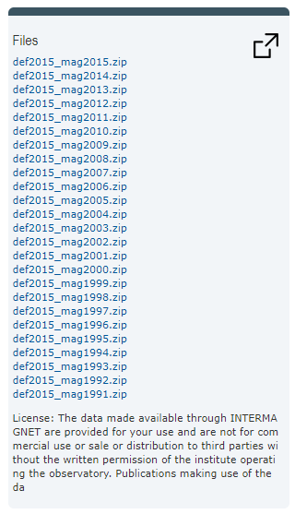
Features of the DOI landing pages Ensure license conditions are clear
Notes:
The INTERMAGNET data licensing conditions are clearly shown on the landing page. These are in the process of being updated to Creative Commons CC-BY-NC, which says that users must give credit to the originators of the data and must not use the data for commercial gain.

Slide 6
Features of the DOI landing pages Access the (immutable) data
Contents of INTERMAGNET Definitive Data DVDs or USB sticks are made available as .tar.gz files
Can be downloaded by ftp
Stored at GFZ library / information service – ensures data can never be changed
Notes:
All the data associated with the DOI is available to download from the landing page. In this case data from 1991 to 2015 are available as individual years of data in a compressed archive. The data associated with this DOI will not change, so users can be sure that they are always able to recreate results produced using this data set. If corrections need to be made in the future to the data for a particular year, the corrections will be made available in a subsequent DOI.

Slide 7
INTERMAGNET Reference Data Set (IRDS) - A Definition
For 2016 and onwards definitive data will be annual on-line publications and include all previously available data (back to 1991) with corrections applied. Data corrections will be overwritten rather than including errata information as has been done in the past. A DOI will be minted for each annual data set. In order to encourage IMOs to submit data in a timely manner the deadline will be set as the publication date for the DOI.
[Minutes of 2019 INTERMAGNET meeting]
Notes:
The INTERMAGNET Reference Data Set will replace the annual single-year publications of definitive data. All data from all years that INTERMAGNET has operated over will be published as a single data set, updating with additional data each year. A DOI will be created for each annual IRDS publication. As with the publication on physical media, there will be a deadline for publication of the DOI and observatories who do not meet the deadline will not have their data published in that publication, though they may be able to publish the data in a future release of the IRDS.

Slide 8
Progress: DOI published for 2015
https://doi.org/10.5880/INTERMAGNET.1991.2015
2015 the last year where data is published on a physical medium
2015 publication contains all INTERMAGNET definitive data from 1991 to 2015
2015 effectively the first year of the INTERMAGNET Reference Data Set
Though we haven’t named it that
There are a few issues remaining with the landing page for the 2015 DOI:
Some small updates needed (e.g. http → https)
Need to find a place for files that are not part of a ‘year’ directory (files such as change log, visualisation software documentation, …)
Notes:
2015 was the last year of publication of data on a physical medium. It was also the first year in which INTERMAGNET published all years of data from 1991 to date. In effect this makes it the first publication of the INTERMAGNET Reference Data Set. The DOI for 2015 is available to view at the link show,

Slide 9
Progress: Compilation of IRDS 2016
2016 data is checked and ready for publication
Once the final small updates have been made to the 2015 DOI landing page, the metadata for the 2015 DOI can be used as the basis for the 2016 DOI landing page.
Notes:
Data for 2016 has been collected, checked and packaged into the standard INTERMAGNET format. The next stage is to create the metadata for the 2016 DOI, and build the DOI landing page.

Slide 10
Future Plans
Finalise 2015 DOI landing page
Create 2016 DOI landing page
Ongoing updates of the IRDS
Create DOIs for ‘historic’ INTERMAGNET publications from 1992 to 2012
Work out how to apply DOIs to preliminary data
Notes:
Future plans for working on DOIs include the regular annual publication of INTERMAGNET definitive data, going back over previous publications to create DOIs for them and starting to work on the more complex issue of issuing DOIs for preliminary data.

