Slide 1
A geomagnetic activity viewer
Simon Flower & Adam Emsley

Slide 2
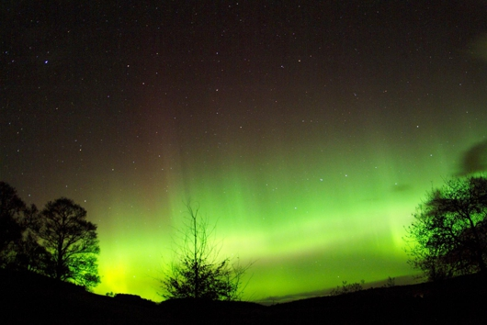
Geomagnetic Activity Viewer
A Geomagnetic activity viewer was available when the Intermagnet data portal was hosted in Canada
Users have expressed interest in bringing back this service
Using data from the World Data Centre extends the timeseries
The HAPI standard simplifies access to Intermagnet and WDC data

Slide 3

Geomagnetic Activity Viewer – what to show?
ΔH/Δt – calculated how:
From H
As $\sqrt{(\text{Δ}\text{X}\text{/}\text{Δ}\text{t}\text{)2 + }(\text{Δ}\text{X}\text{/}\text{Δ}\text{t}\text{)2 }}$
ΔX/Δt
ΔY/Δt

Slide 4
Geomagnetic Activity Viewer
http://webserver-geomag-3403-main.kube-idev.bgslcdevops.test/test/deltahviewer/deltaHViewer.html
Notes:
Things to demonstrate:
Select observatories
1st observatory displayed shows most recent data
Turn observatories off and on
Sort for observatories in dialog
Show date selection + back/forward
Storm: 2024/05/10 – LER (no OTT)
Storm: 1989/03/13 - OTT - uses WDC as well as Intermagnet data
Options:
Traces
Show ASP and BEL – to see problems with reported data
Autoscale / fixed scale
Plotly + mode bar:
Double click on legend for individual trace
Data statistics
Data availability
Zooming
Image download

Slide 5
Questions
Is it sufficiently clear how the traces are calculated?
Currently only works with 1-minute data - would it be useful to add 1-second data?
Are people interested in an app that presents a stack plot of data, e.g. for the current day?

